Slide 1

Internship Projects Report
- YASH SONI

Slide 2

Project 1 : Airbnb Data Analysis
* Introduction
* Primary goals
* Business Needs
* Tableau Dashboard

Slide 3

Introduction
The Airbnb Data Analysis Tableau Dashboard provides an interactive visualization of key metrics such as average rental prices, occupancy rates, and guest reviews to help hosts make data-driven decisions and improve their listings' performance.

Slide 4

Primary goals
To provide hosts with a clear overview of their listing's performance and identify areas for improvement.
To help hosts make data-driven decisions to increase their revenue and occupancy rates.
To visualize key metrics such as rental prices and guest reviews for easy comparison with competitors.
To provide a user-friendly and interactive platform for hosts to analyze their data and track their progress over time.

Slide 5
Business Needs
To provide hosts with insights into their listings' performance to increase revenue and occupancy rates.
To help hosts make data-driven decisions and improve the quality of their listings to attract more guests.
To enable hosts to identify trends and patterns in guest behavior and preferences to enhance the guest experience.
To provide a competitive edge for hosts by comparing their performance with similar listings in the market.
To increase customer satisfaction and loyalty by improving the quality of listings and enhancing the overall guest experience.

Slide 6
Tableau Dashboard
Interactive Dashboard Link :-
https://public.tableau.com/views/Airbnb_Data_Analysis_New_York_City/Dashboard1?:language=en-GB&:display_count=n&:origin=viz_share_link

Slide 7
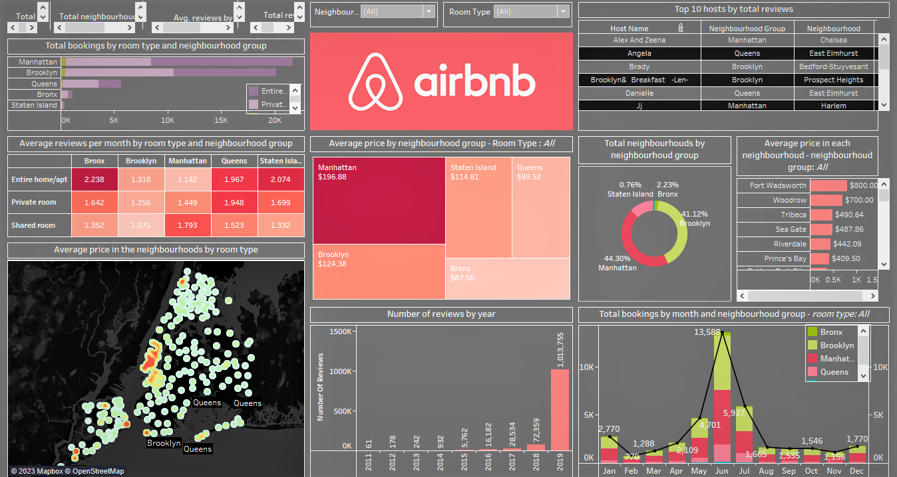

Slide 8

Project 2 : Employee Attrition Analysis
* Introduction
* Primary goals
* Business Needs
* Tableau Dashboard

Slide 9
Introduction
The Employee Attrition Tableau Dashboard provides an interactive visualization of key metrics such as employee turnover rate, reasons for leaving, and demographics to help HR managers identify patterns and make data-driven decisions to reduce attrition and improve employee retention.

Slide 10
Primary goals
To help HR managers identify the underlying causes of employee turnover and take corrective action to reduce attrition rates.
To provide an interactive platform to explore and visualize key metrics related to employee attrition, such as employee demographics and reasons for leaving.
To enable HR managers to track attrition rates over time and identify trends or patterns.
To identify areas for improvement in the employee experience, such as training and development, compensation, and benefits.
To increase employee retention and satisfaction by addressing the root causes of attrition.

Slide 11
Business Needs
To reduce the cost of recruiting and training new employees by identifying and addressing the root causes of attrition.
To improve employee morale and job satisfaction by addressing the issues that lead to turnover.
To improve workforce planning by identifying trends and patterns in employee attrition rates and taking proactive measures to retain employees.
To increase productivity and reduce disruption to business operations by maintaining a stable and experienced workforce.
To ensure compliance with legal and regulatory requirements related to employee turnover and retention.

Slide 12
Tableau Dashboard
Interactive Dashboard Link :-
https://public.tableau.com/views/HRAnalyticsDashboard_16825829983180/HRANALYTICSDASHBOARD?:language=en-GB&:display_count=n&:origin=viz_share_link

Slide 13
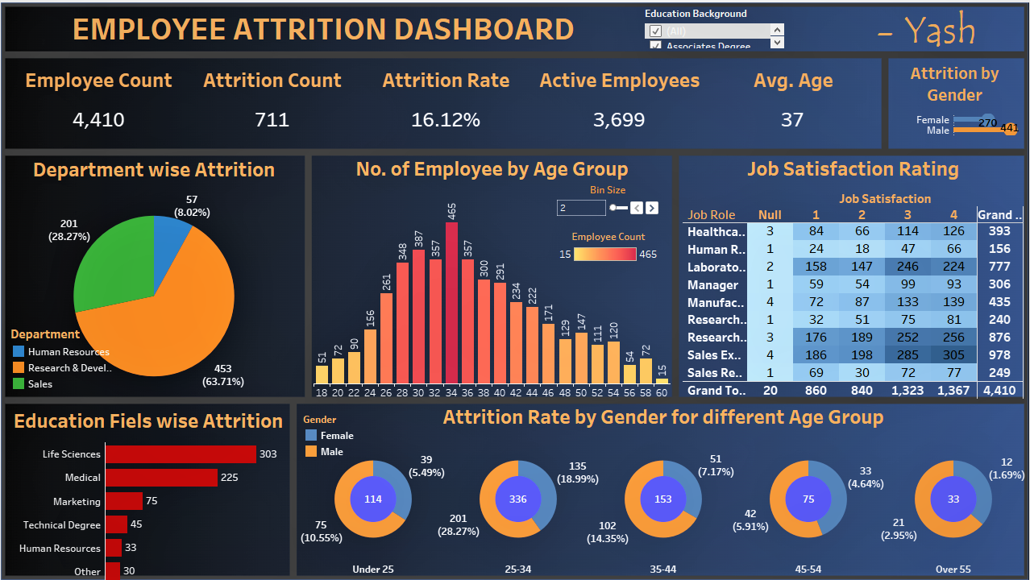

Slide 14
Thank you
Yash Soni​
yashmukeshsoni@gmail.com
https://www.linkedin.com/in/yash-soni-9672bb1ba/

